Slide 1

Artificial Intelligence: Theory & Lab Integration
North East university• Instructor: Mr. Razorshi Prozzwal Talukder• Spring 2025

Slide 2





What is Artificial Intelligence?
Artificial Intelligence (AI) is a transformative field within computer science, dedicated to equipping machines with capabilities traditionally
associated with human intellect. This includes learning, problem-solving, decision-making, and pattern recognition.
Practical Application: Autonomous Vehicles
Self-driving cars exemplify AI in action. They leverage advanced AI algorithms to comprehend their surroundings, interpret complex data, anticipate movements, and make instantaneous driving decisions. These systems are continuously learning to optimize routes, skillfully avoid obstacles, and adapt to diverse conditions, thereby enhancing safety and efficiency in transportation.
Key Applications of AI
Healthcare Innovation
AI is revolutionizing healthcare, aiding in precise disease diagnosis, accelerating drug discovery, enabling personalized treatment plans, and powering advanced robotic surgeries. This dramatically improves patient outcomes and care delivery.
Transforming Education
AI is reshaping education through personalized learning experiences, automated assessment and grading systems, and intelligent tutoring platforms. These innovations adapt dynamically to individual student needs, fostering more effective learning.
Financial Sector Augmentation
Advanced Smart Automation
In finance, AI is indispensable for robust fraud detection, sophisticated algorithmic trading strategies, accurate credit scoring, and superior customer service. It significantly boosts operational efficiency and strengthens security measures.
AI underpins intelligent automation across various domains, from smart home assistants to industrial robots. It optimizes complex supply chains, refines energy grid management, and enhances overall productivity in both domestic and industrial settings.

Slide 3

A Brief History of AI
1950s: Birth of a Field
1980s-90s: Neural Networks & Machine Learning Resurgence
John McCarthy coined "Artificial Intelligence" in 1956 at the Dartmouth Conference. Alan Turing's theoretical work, including the Turing Test, laid groundwork, and early programs showed basic problem-solving.
The 1980s saw neural network resurgence with backpropagation. Expert systems were commercialized. The 1990s brought statistical ML breakthroughs in speech and vision, highlighted by IBM's Deep Blue defeating Garry Kasparov.
1960s-70s: Symbolic AI & Early Systems
2000s-2020s: Modern AI Explosion
Research focused on symbolic AI, developing expert systems (e.g., MYCIN) and early NLP programs (ELIZA). Despite progress, over-optimistic predictions led to the first "AI Winter."
Rapid AI acceleration in the 2000s-2010s due to big data and computing led to breakthroughs in computer vision, NLP, and game-playing (e.g., AlphaGo). The 2020s brought generative AI (e.g., ChatGPT), making AI ubiquitous.

Slide 4




Course Objectives
Master Core AI Concepts
Design Intelligent Agents
Gain a profound understanding of foundational artificial intelligence principles and theories.
Learn to conceptualise and architect autonomous agents capable of rational decision-making.
Implement Algorithms
Build AI Applications
Practically apply search and decision-making algorithms through hands-on coding exercises.
Develop functional AI-powered applications, including games and classification systems.

Slide 5
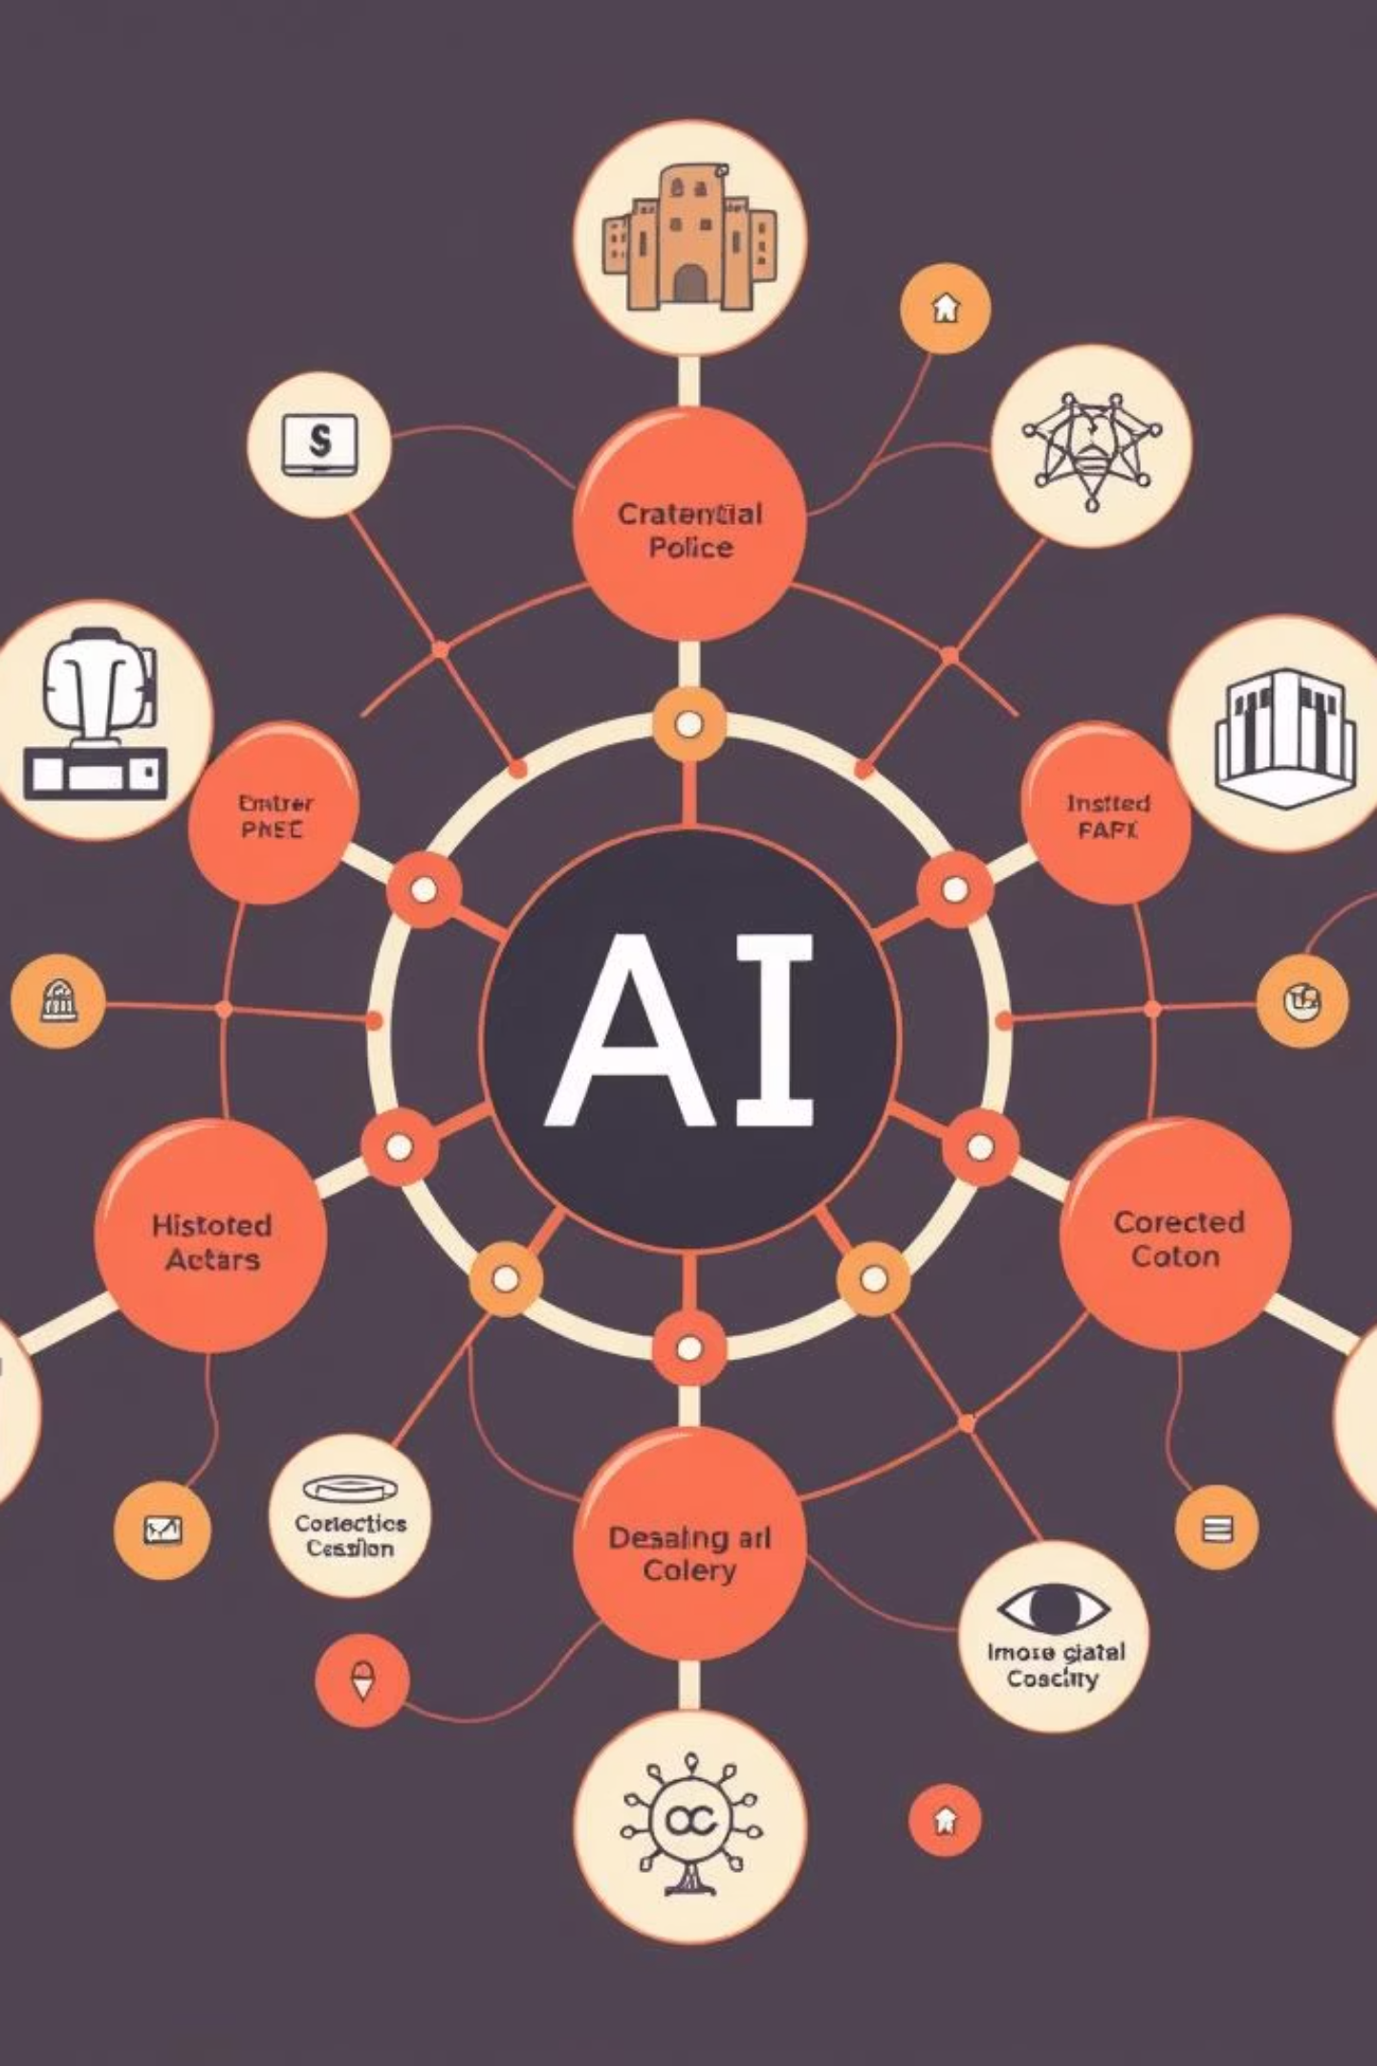
Core Theory Topics
History & Foundations of AI:
Agent Types & Architectures:
Tracing the evolution of AI from early concepts to modern paradigms.
Exploring different types of intelligent agents and their structural designs.
Search Strategies:
Knowledge Representation:
In-depth study of Breadth-First Search (BFS), Depth-First Search (DFS), A* search, and Minimax algorithms.
Techniques for representing information, including logic and inference methods.
Introduction to ML & NLP:
Fundamental concepts in Machine Learning and Natural Language Processing.

Slide 6


Uninformed Search Algorithms
✅ Lab Integration:
Explore classic algorithms used when no prior knowledge of the problem
space is available:
Hands-on Python implementation of maze solvers using these uninformed search techniques, visualising pathfinding.
BFS (Breadth-First Search): Explores level by level, guaranteeing shortest path in terms of steps.
DFS (Depth-First Search): Explores as far as possible along
each branch before backtracking.
IDS (Iterative Deepening Search): Combines BFS's completeness with DFS's memory efficiency.
Bidirectional Search: Simultaneously searches from both start and goal nodes, often reducing search time.
DLS (Depth-Limited Search): A DFS variant that prevents infinite
loops in cyclic graphs.

Slide 7
Informed (Heuristic) Search
Best-First Search & A*
Heuristics Design & Admissibility
✅ Lab Integration: A* Pathfinding
Delve into search algorithms that use heuristic functions to guide their exploration, optimising for efficiency. A* search combines the advantages of Dijkstra's algorithm and Greedy Best-First Search for optimal pathfinding.
Understand the principles of designing effective heuristic functions and the concept of admissibility, ensuring the heuristic never overestimates the cost to reach the goal.
Develop and visualise an A* pathfinding algorithm in a simulated environment, demonstrating its efficiency in finding optimal routes.

Slide 8

Game Playing & Minimax
Explore the theory behind AI game playing, focusing on adversarial search algorithms:
✅ Lab Integration:
Minimax Algorithm: A decision rule used in artificial intelligence, decision theory, game theory, and statistics for minimising the possible loss for a worst case (maximum loss) scenario.
Construct a graphical user interface (GUI) game in Python where students program an AI opponent utilising Minimax and Alpha-Beta Pruning.
Alpha-Beta Pruning: An optimisation technique for minimax that reduces the number of nodes evaluated in the search tree.
Apply these concepts to classic games like Tic-Tac-Toe and Chess.

Slide 9
Logic & Knowledge Representation
First-Order Logic (FOL)
Propositional Logic
Delve into the more expressive First-Order Logic, covering predicates, quantifiers, and inference rules for complex knowledge representation.
Introduction to the fundamentals of propositional logic, including syntax, semantics, and truth tables.
✅ Lab Integration: Puzzle Solver
Inference via Resolution
Implement a puzzle solver in Python that leverages First-Order Logic for knowledge representation and automated reasoning.
Learn how to perform logical inference using the resolution principle, a key method for automated theorem proving.

Slide 10

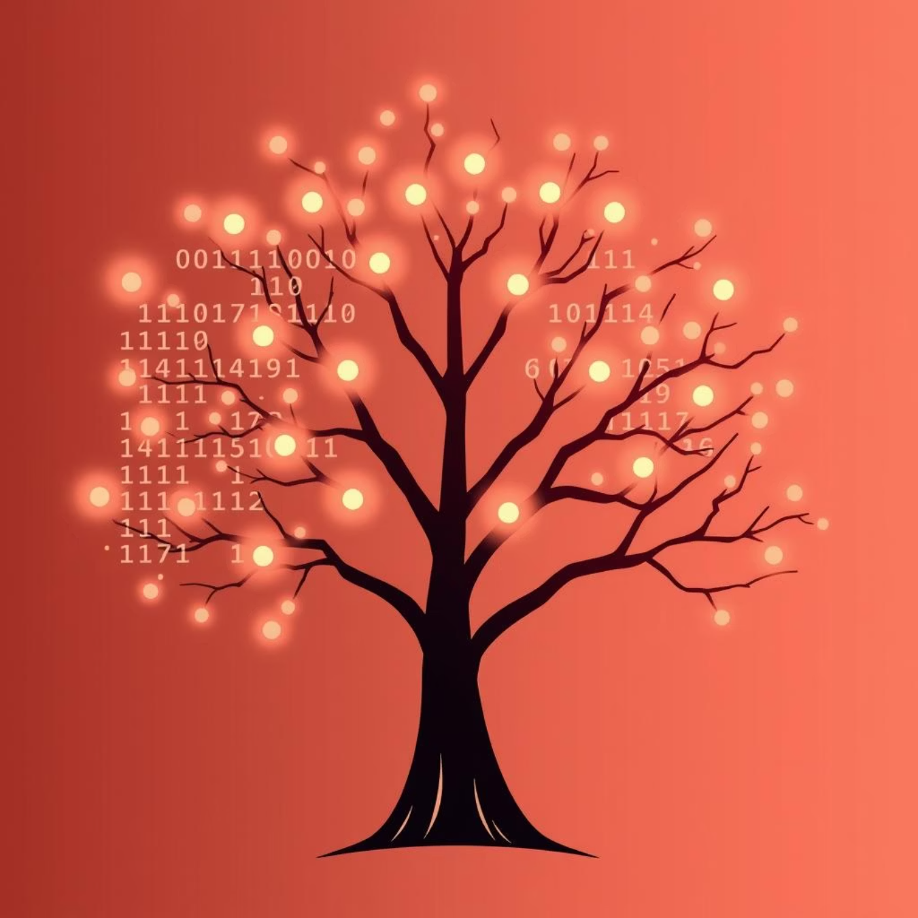
Introduction to ML & NLP
📘 Machine Learning (ML)
Machine Learning allows computers to learn from data and make predictions or decisions without being explicitly programmed.
Types of Learning:
Supervised Learning – learns from labeled data
Unsupervised Learning – finds patterns in unlabeled data
Examples:
Email spam filter
Product recommendation systems
🌐 Natural Language Processing (NLP)
NLP enables machines to understand and process human language.
Tasks in NLP:
Text classification (e.g., spam detection)
Tokenization (splitting sentences into words)
Sentiment analysis
✅ Lab Integration:
Prototype a spam detector using learned ML/NLP techniques, applying classification algorithms to real-world text data.

Slide 11
Lab Summary & Tools
Completed Tasks
Over 8 hands-on tasks covering search algorithms, game AI, logic puzzles, and machine learning applications.
Primary Tools
Python, Tkinter for GUI development, Jupyter Notebooks for interactive coding, and GitHub for version control and collaboration.
Code & Reports
All lab code, reports, and project documentation are accessible on the shared GitHub repository: [GitHub link].
This comprehensive lab component ensures practical experience alongside theoretical knowledge, preparing students for real-world AI challenges.

Slide 12




Skills & Future Applications
Algorithmic Thinking
Python AI Coding
Enhanced abilities in breaking down complex problems and devising efficient, logical solutions.
Proficiency in implementing various AI algorithms using Python, a leading language in the field.
Intelligent Agent Design
Real-World Readiness
Capability to design and develop sophisticated intelligent agents and engaging AI-powered games.
Equipped to confidently approach and solve real-world AI projects and challenges across various industries.

